Slide 2
Networking with java.net
Networking fundamentals
The Networking classes and Interfaces
The InetAddressclass
The Socket Class
The URL class
The URLConnection Class
The HttpURLConnection Class

Slide 3
Networking Fundamentals
Socket
A socket identifies an endpoint in a network.
Protocol
It is a program
It represents highlevel data in the form of its equivalent machine level data and is responsible for transmitting this data from one domain to another domain.
Internet Address
Is a number that uniquely identifies each computer on the Net.

Slide 4
Networking Fundamentals
Port
The port number is used to uniquely identify different applications. It acts as a communication endpoint between applications.
The port number is associated with the IP address for communication between two applications.
Protocol classification
Connection-oriented protocol
Connectionless protocol
TCP
Is a higher level protocol that manages the transmission of packets
UDP
Connectionless transmission of packets

Slide 5
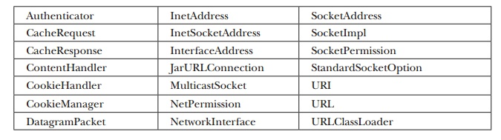
The Networking classes and interfaces
Java Provides extensive support for the TCP and UDP protocol families

Slide 6
The interfaces in java.net include
ContentHandlerFactory | CookiePolicy | CookieStore
DatagramSocketImplFactory | FileNameMap | ProtocolFamily
SocketIMPlFactory | SocketOption | SocketOptions
URLStreamHandlerFactory

Slide 7
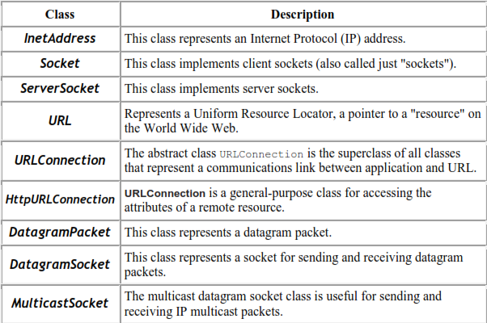
Networking Classes

Slide 8
InetAddress
InetAddress class Represents: An IP address.
Can convert domain name to IP address
Perform DNS look-up
Does not have any constructor.
To create an InetAddress object, use following factory methods.
getLocalHost ( ) throws UnknownHostException
getByName (String hostName) throws UnknownHostException
getByAddress( ) throws UnknownHostException

Slide 9
All above methods returns object to InetAddress.
getLocalHost( ) method simply returns the InetAddress object that represents local host.
getByName( ) method returns an InetAddress for a host name passed to it.
If these methods are unable to resolve the host name, they throw an UnknownHostException.
getByAddress( ), which takes an IP address and returns an InetAddress object.

Slide 10
Socket
A socket identifies an endpoint in a network.
Socket allows a single computer to serve many different clients at once.
A server process is said to ―listen‖ to a port until a client connects to it.
A server is allowed to accept multiple clients connected to the same port number.
Socket communication takes place via a protocol.
Internet Protocol (IP) - - is a low-level routing protocol.
breaks data into small packets and sends them to an address across a network.
Transmission Control Protocol (TCP) - is a higher-level protocol.
User Datagram Protocol (UDP)-support fast, connectionless, unreliable transport of packets

Slide 11
Socket Class
TCP/IP reserves the lower 1,024 ports for specific protocols. Many of these will seem familiar to you if you have spent any time surfing the Internet.
Socket Class
TCP/IP sockets are used to implement reliable connections between hosts on the Internet.
There are two kinds of TCP sockets in Java
The ServerSocket class is for servers. It is designed to be a “listener,” which waits for clients to connect before doing anything.
The Socket class is for clients. It is designed to connect to server sockets and initiate protocol exchanges.

Slide 12
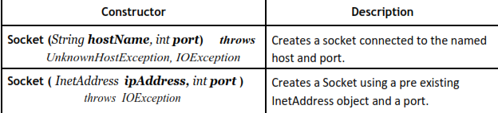
The creation of a Socket object establishes a connection between the client and server.

Slide 13
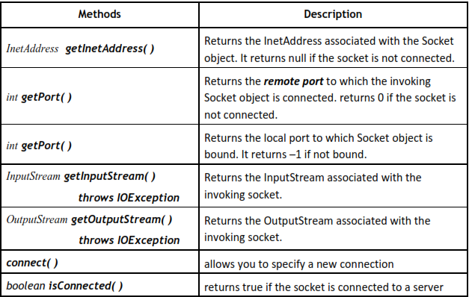
Socket defines several instance methods.

Slide 14
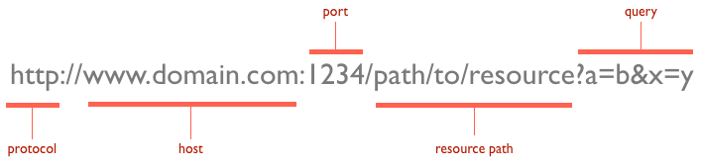
Class URL
The modern Internet is not about the older protocols such as whois, finger, and FTP. It is about WWW, the World Wide Web.
2. The Uniform Resource Locator (URL) uniquely identify on the Internet.
3. All URLs share the same basic format, although some variation is allowed.
4. A URL specification is based on four components.

Slide 15
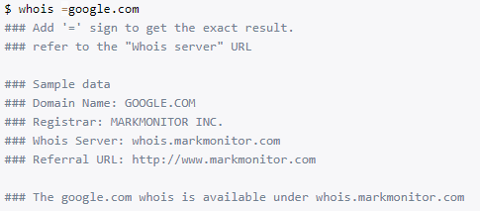

Slide 16
Class URL
The first is the protocol to use:
Separated from the rest of the locator by a colon (:).
Common protocols are HTTP, FTP, gopher, and file.
http://www.google.com/
ftp//....
B. The second component is the host name or IP address of the host to use;
Delimited on left by (//) and on the right by (/) or optionally a colon (:).
h t t p://www.google.com:80/index.html
h t t p://www.google.com/index.html

Slide 17
Class URL
C. The third component, the port number (optional),
Delimited on left after host name by (:) and on the right by (/).
It defaults to port 80, the predefined HTTP port; thus, “:80” is redundant.
D. The fourth part is the actual file path.
Most HTTP servers will append a file named index.html

Slide 18
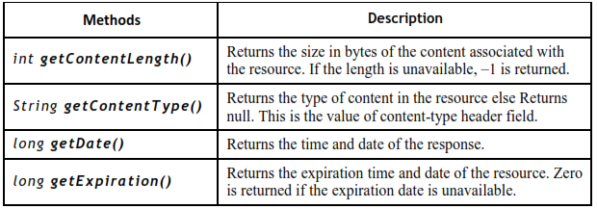
The URLConnection CLASS
URL-Connection is an abstract class that encapsulates a URL-based connection.
Once you make a connection to a remote server, you can use URLConnection to inspect the properties of the remote object before actually transporting it locally.
These attributes are exposed by the HTTP protocol specification and, as such, only make sense for URL objects that are using the HTTP protocol.

Slide 19
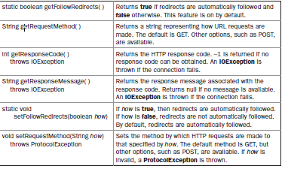
Class HttpURLConnection
Java provides a subclass of URLConnection that provides support for HTTP connections. This class is called HttpURLConnection.

